Slide 1
Parts of Speech Tagger for Nepali Text Using Support Vector Machine
Raju Shrestha
Roll No. 48/2079
December 6, 2024

Slide 2
OVERVIEW
Introduction
Problem Statement
Objectives
Literature Review
Methodology
Implementation & Testing
Result & Analysis
Conclusion

Slide 3
INTRODUCTION
Parts of Speech tagging is the initial and most significant step in Natural Language Processing.
Task of assigning the appropriate parts of Speech tag for input text.
Various applications such as machine translation, speech recognition and speech synthesis, grammar checker, named entity recognition, question answering and information retrieval are dependent on this.

Slide 4
PROBLEM STATEMENT
POS Tagging is considered as one of the core part of NLP, manually assigning tags to a large corpus becomes work-intensive.
The performance of various NLP task like chunking, parsing, stemming, translation etc. depends upon the performance of tagger.
It can be further used in other application domains such as machine translation, speech recognition and speech synthesis, grammar checker, named entity recognition, question answering and information retrieval.
Hence, it is required to build a computer program (tagger) that automatically assign POS tags to a words in natural language and it should be fast, accurate, portable and trainable.
But, the most challenging problem in POS tagging is to determine the proper context and features for Nepali language which is morphologically rich.

Slide 5
OBJECTIVES
To build a Parts of Speech tagger that automatically assign POS tags to each words for an input text based on its definition and context.

Slide 6
LITERATURE REVIEW
Various techniques like rule based, statistical, probabilistic, machine learning, neural network and deep learning techniques are used for Nepali POS tagging.
Machine learning technique like SVM performs better than TnT based tagger.
Neural Network techniques like RNN, GRNN and Feed Forward Neural Network are carried out. However, GRNN performs better than other.
Comparing with GRNN & Viterbi based tagger, Viterbi performs better.

Slide 7
LITERATURE REVIEW
Different variants (bi-directional & uni-directional) of Deep learning techiques like RNN, GRU, LSTM are carried out. However, bi-directional variants performs better than other.
Bi-directional variants with more embedding size and loss function changing from categorical cross entropy to binary cross entropy performs better.
Bi-directional LSTM out performs better than RNN & GRU.

Slide 8
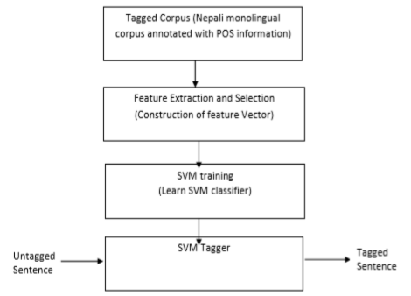
METHODOLOGY
POS tagging of Nepali text uses supervised machine learning algorithm i.e. SVM.
The SVM tagger assigns the appropriate
POS tag to each input word.

Slide 9
METHODOLOGY…
Data Collection:
Dataset used for POS tagger for Nepali text is Nepali Monolingual Written Corpus which contains 14 million Nepali word.
It consists of two corpus: core and general.
The core corpus consists written texts from 15 different genres with 2000 words & the general corpus consists of written text collected from a wide range of sources such as the books, journals, magazines, newspapers and internet webs.
The written corpus is morphologically-annotated i.e. the text is divided into tokens.

Slide 10
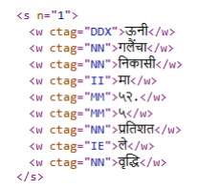
METHODOLOGY…
The written corpus is in XML format where a paragraph, sentences and the words are enclosed with tag with its POS tag specified as the value of attribute ‘ctag’.
There are a total of 112 POS tags in the corpus denoted by roman alphabetic symbols.
Nepali POS Dataset Sample

Slide 11
METHODOLOGY…
Construction of Train and Test Set:
Firstly, the XML based corpus is parsed to obtain a train and test set of data.
The words and their respective tags are extracted from the Nepali National Monolingual Written Corpus.
Further, another test set is created from the raw unprocessed text, which is not lemmatized to test the accuracy of training model.

Slide 12
METHODOLOGY…
Feature Extraction:
Feature extraction is the process of transforming arbitrary data, such as text or images, into numerical features usable for machine learning.
Word feature of each word in a sentence is extracted to derive relevant information about that word and its POS tag & and then stored as lists of dictionary objects.
Dictionary Vectorizer:
Transforms the dictionary objects into feature arrays and convert to feature vectors.

Slide 13
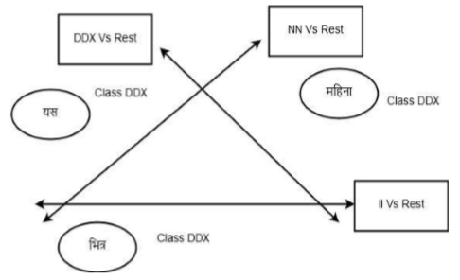
METHODOLOGY…
SVM Classifier:
Find the best splitting boundary between the words. This fit the data and return a "best fit" hyperplane which correctly separates the data into two classes.
One Vs Rest classification strategy is used for the binarization of Multiclass Classification.
One Vs Rest Classification

Slide 14
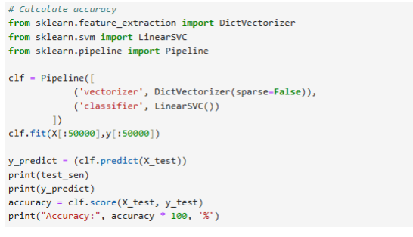
METHODOLOGY…
Model Training:
For training model SVM is used. It is commonly used in NLP for document classification tasks.
SVM is computationally efficient and can handle large datasets with many features.
Model Prediction:
For prediction linearSVC classifier is used.
DictVectorizer is used as vectorizer.
Accuracy score is calculated.
Model Prediction

Slide 15
IMPLEMENTATION & TESTING
The algorithm is implemented using Python programming language and Jupyter notebook as software environment.
Flask (python web framework) is used for developing web application.
The various libraries used are:
Pandas: Used for data analysis and manipulation.
Numpy: Used for working with arrays and matrices.
Matplotlib: Used for 2D visualization.
Sci-kit learn: Simple and efficient tools for predictive data analysis.
NLTK: It can be used to perform various NLP task such as tokenization, stop words removal, stemming, lemmatization, parse tree generation, & parts of speech (POS) tagging etc.

Slide 16
IMPLEMENTATION & TESTING
Testing was performed on both lemmatized test data as well as raw unprocessed test data.
Major Functions used:
ParseXMLCorpus: Takes the path of XML files & parse the annotated corpus and design a training set for the application.
getFeatures:Takes list of words in a sentence and their indices then extracts the word features and POS features of each word in a sentence and stores in a dictionary object.

Slide 17
IMPLEMENTATION & TESTING
DictVectorizer: It takes dictionary-like object where feature names are mapped to feature values then it transforms those dictionary-like objects of features into Numpy array.
LinearSVC : It takes Numpy array & perform various functions then this is used to fit the data you provide and return a "best fit" hyperplane that divides, or categorizes, your data.

Slide 18
RESULT AND ANALYSIS
The average accuracy for testing lemmatized text data is 86.15% and for unprocessed raw text is 72%.
The result obtained in the testing phase shows drastic variation in the efficiency of tagger between the lemmatized test data and unprocessed raw test data.

Slide 19
RESULT AND ANALYSIS
Findings:
Postpositions haruu, ko/kii/kaa, le, laaii and maa, baaTa, sanga, dekhi are necessarily tokenized separately to the forms to which they are attached, and tagged separately.
Gender distinction like o/ii/aa distinction is ignored on nouns, but not on adjectives, pronouns, adjectives, non-finite verbs.
Nepali has a great range of verb inflections. If every distinction made in the verb system were to be indicated by a separate tag, then the tags for verbs would become entirely unmanageable.

Slide 20
CONCLUSION
POS Tagging is an important task in the field of NLP. It is useful for various application domains such as Machine Translation, Speech Recognition and Speech Synthesis, Grammar Checker, Named Entity Recognition, Question Answering and Information Retrieval etc.
SVM based tagger is developed that assigns the most appropriate POS tag to each word.
The train word sample cannot represent all the Nepali words.
Stemmer/Morphological Analyzer for text preprocessing and normalization is recommended to increase the accuracy.

Slide 21
REFERENCES
[1] B. K. Bal and P. Shrestha, "Reports on Computational Grammar," Madan Puraskar Pustakalaya, Patan Dhoka, Lalitpur, Kathmandu.
[2] T. B. Shahi, T. N. Dhamala and B. Balami, "Support Vector Machines based Part of Speech Tagging for Nepali Text," International Journal of Computer Applications, vol. 70–No.24, no. May 2013.
[3] A. Hardie, R. R. Lohani, B. N. Regmi and Y. P. Yadava, "A morphosyntactic categorisation scheme for the automated analysis of Nepali," in Annual Review of South Asian Languages and Linguistics, De Gruyter Mouton, 2009.
[4] A. Yajnik, "ANN Based POS Tagging For Nepali Text," nternational Journal on Natural Language Computing (IJNLC), vol. 7, no. June 2018.
[5] A. Yajnik, "GENERAL REGRESSION NEURAL Newtork Based POS Tagging For Nepali Text," Department of mathematics, Sikkim Manipal University, Sikkim , India,, no. July 2018.

Slide 22
REFERENCES…
[6] A. Yajnik, "Part of Speech Tagging Using Statistical Approach for Nepali Text," International Journal of Cognitive and Language Sciences, vol. 11, 2017.
[7] P. Greeshma, P. Jyothsna, K. Shahina and B. Premjith, "A Deep Learning Approach for Part-of-Speech Tagging in Nepali Language," in International Conference on Advances in Computing, Communications and Informatics, IEEE, 2018.
[8] S. Sayami, T. B. Shahi and S. Shakya, "Nepali POS Tagging using Deep Learning Approaches," EasyChair, no. 1 December 2019.
[9] B. Prasain, L. Khatiwada, B. K. Bal and P. Shrestha, "Part-of-speech Tagset for Nepali," Madan Puraskar Pustakalaya, 2008.

Slide 23
Thank You

